Slide 1
Astronomy Observation with Raspberry Pi
Introduction to my telescope project
-- by Jack Zhu lczhu@msn.com
Feb 2019

Slide 2
Agenda
Original Motivation
Project Status
Project details
Demo
Future Plan
Useful Resources
Q&A

Slide 3
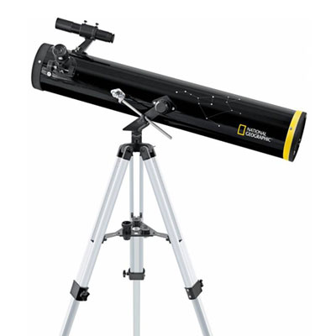
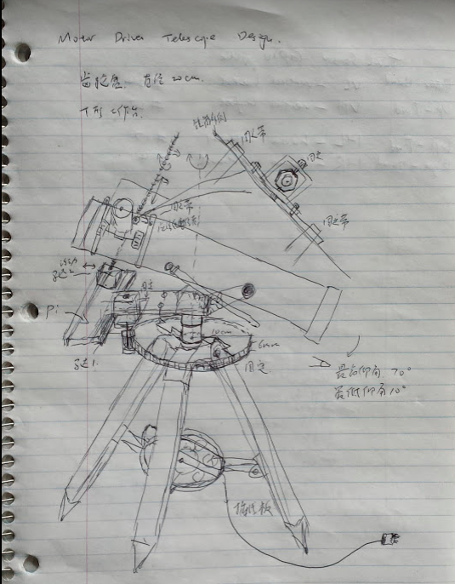
Original Motivation
In 2013, I got a 76/700mm used National Geographic reflector telescope from my colleague. This inspired my intention to build a robotic-controlled telescope.
My intention is to make the most use of an amateur telescope using Raspberry Pi and its accessories.
Here is the original blue print …
Here is what it looks like after 4 years of tweeking ...

Slide 4
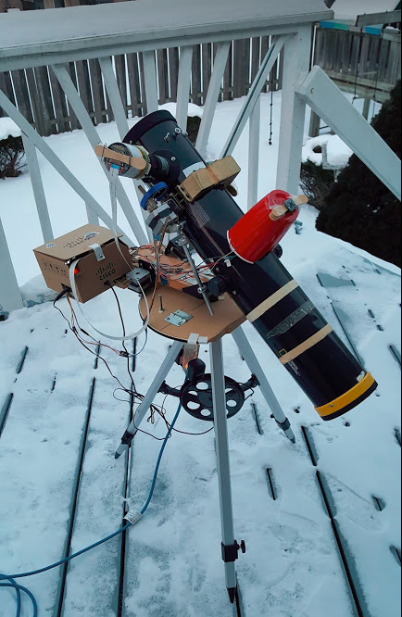
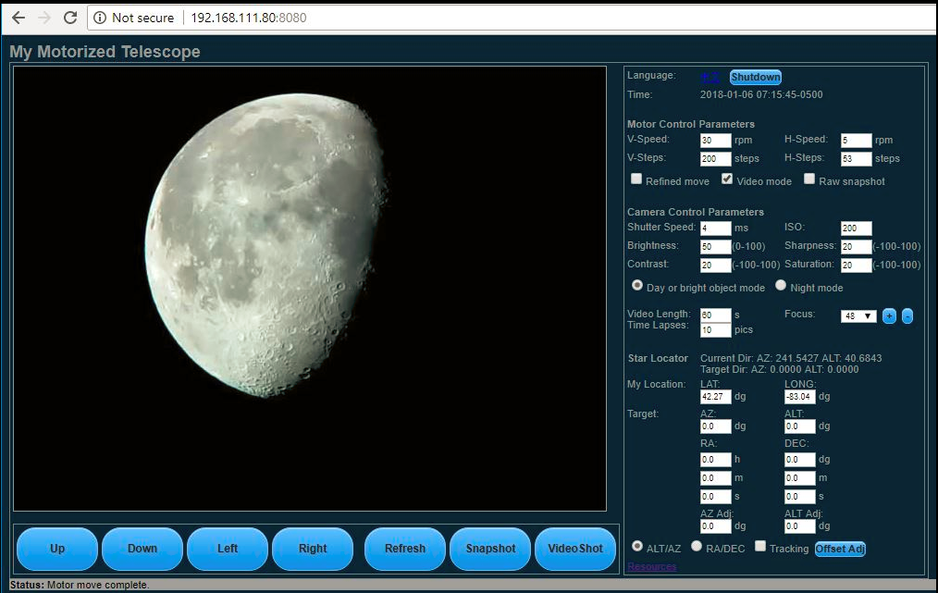
Recent Status

Slide 5
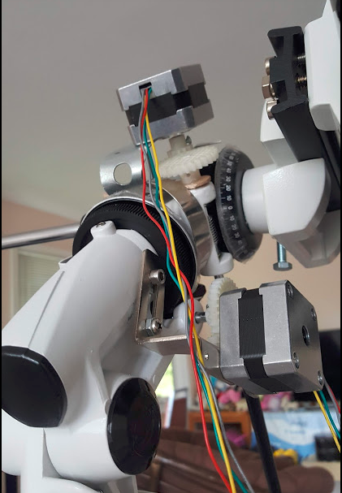
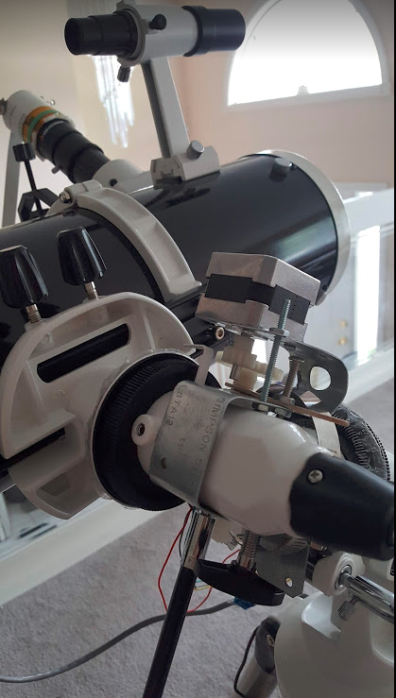
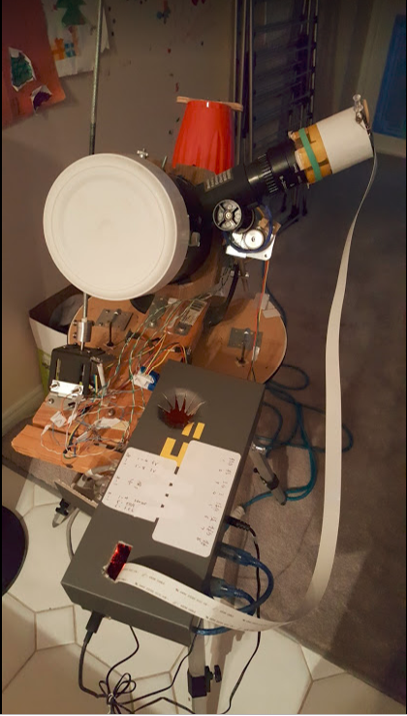
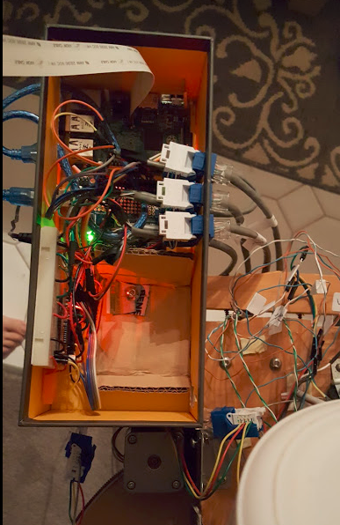
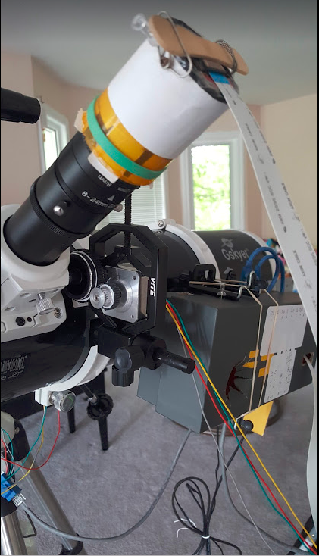
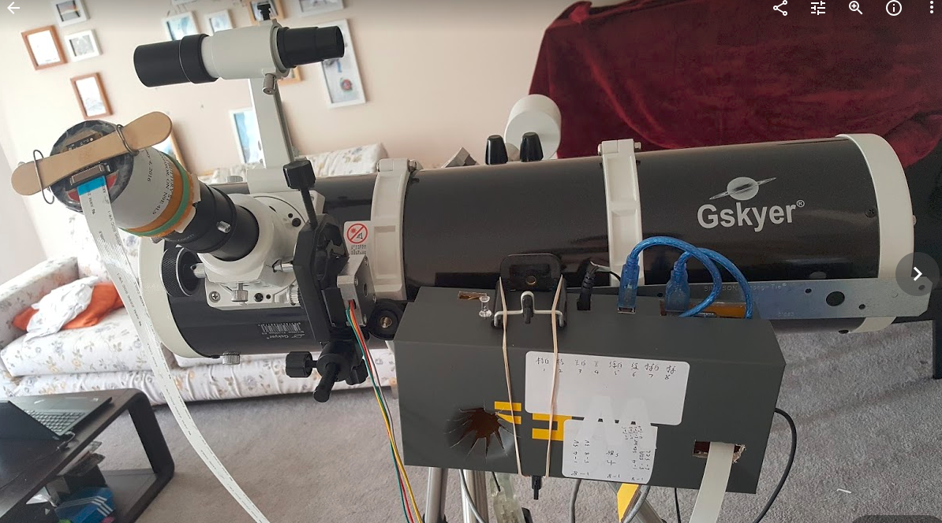
Current Status

Slide 6
Project Details
Supported Features:
Remote control through web interface using wifi
Motorized vertical/horizontal or RA/Dec motion control and focus adjustment
Optical parameters adjustment (ISO, Shutter speed etc), snapshot/video mode, raw image & time series image taken
Star location and tracking (still under development)

Slide 7
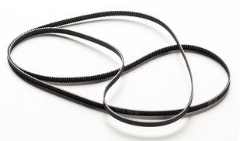
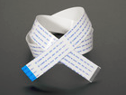
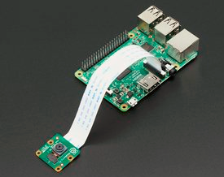
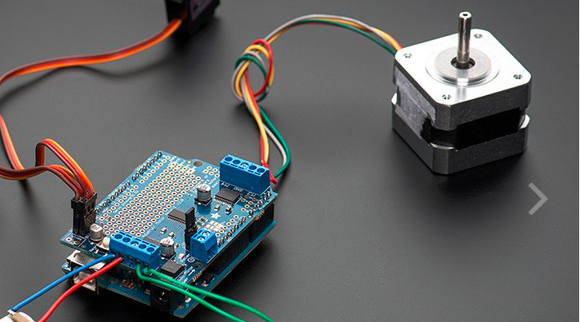
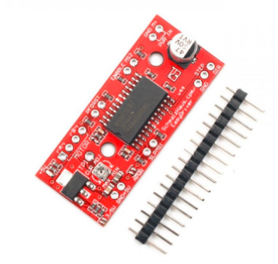
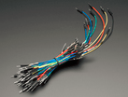
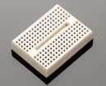
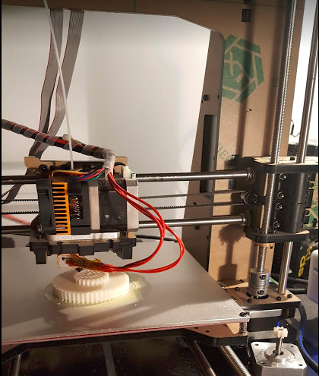
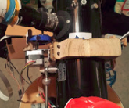
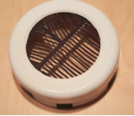
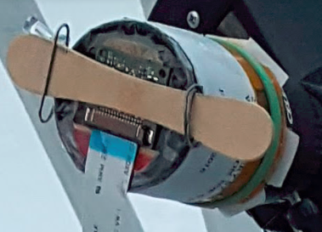
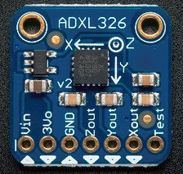
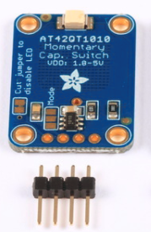
Project Details - Hardware
Accessories
RaspBerry Pi & Pi Camera
Arduino Uno & Motor Control Shield
Stepper Motors, motor control boards
Sensors (compass, accelerometer, touch)
Lots of wood work (Fixtures), plastic work, 3d print work (filters, adaptors, gears)
Notes:
Pi 3 model B - 64bit ARM cpu, 1G ram, built in wireless network adaptor, 40 GPIO pins
Pi camera - 8M pixels, two models: regular and NoIR near infrared,
Total investment ~$400

Slide 8
Project Details - Software
Operation System: Raspbian (a Debian-based linux system for Raspberry Pi)
Mainly coded in Python: http module, RESTful API + Javascript on client side
Serial interface to control Stepper Motors’ movement through Arduino Uno
raspistill/raspivid for static image and video capture - full control of optical parameters
FFmpeg for video streaming conversion
Node-js websocket module for redirecting FFmpeg video stream to web
All source code available at https://github.com/Azz1/projects

Slide 9
Demo
https://drive.google.com/open?id=0B7ehF7N1HUVkZUVZZzFwdTRuTTQ
https://www.dropbox.com/sh/rvsq24ifeaqlkgl/AAByhEUK6FusGNWdisJk0C7fa?dl=0

Slide 10
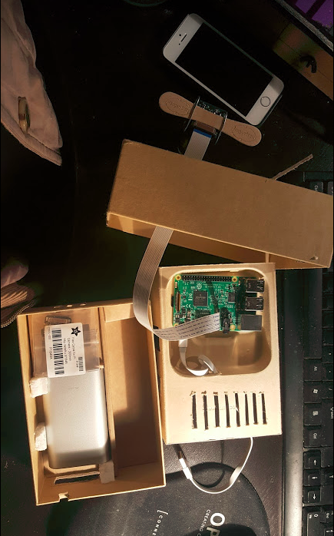
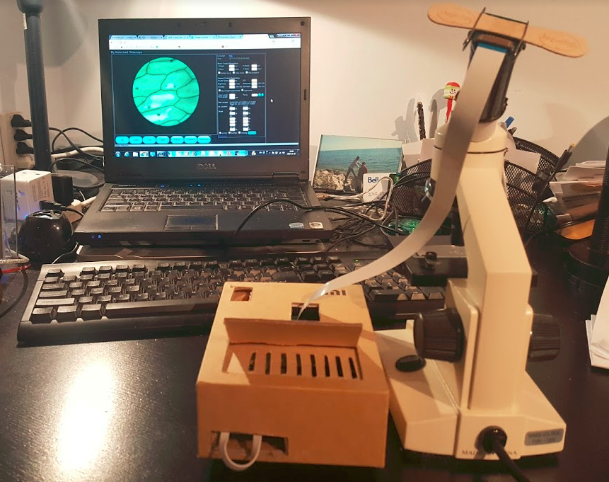
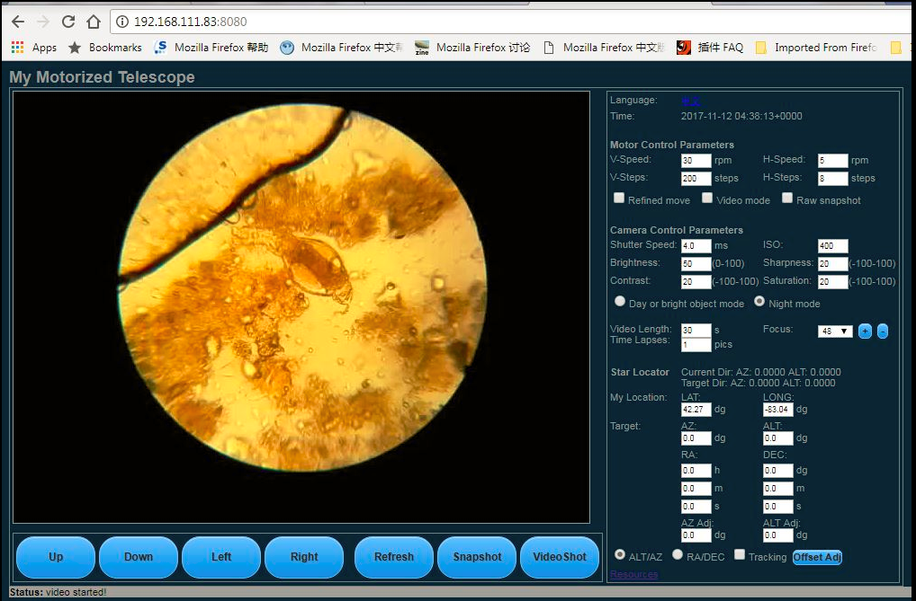
Future Plan
More precise positioning, more smooth motion control
Reduce the interference of electronic components
Portable derivations

Slide 11
Useful Resources
Stellarium Astronomy software http://stellarium.org/
Star Plate-Solving http://nova.astrometry.net/
RA & DEC Conversion from HH:MM:SS to Degrees https://www.swift.psu.edu/secure/toop/convert.htm
Post Processing Software: Registax, DeepSkyStacker
Extracting Raw image data: dcraw
Create Bahtinov mask to help focusing at dark night http://astrojargon.net/MaskGenerator.aspx?AspxAutoDetectCookieSupport=1

Slide 12
Q & A

